Slide 1
SECURITIES & EXCHANGE COMMISSION OF PAKISTAN
Limited Liability Partnership (LLP)

Slide 2
Legal Frame Work
LLP is established and governed under;
Limited Liability Partnership Act, 2017
Limited Liability Partnership Regulations, 2018
S.R.O. 655 (I)/2018 dated May 24, 2018- appointment of Company Registrars as Registrars of LLP.
S.R.O. 656 (I)/2018 dated May 24, 2018-Notification of CROs jurisdiction for registration of LLPs

Slide 3
Differnce Between LLP & Firm
Governing Law | It is registered under LLP Act, 2017 | It is registered under Partnership Act, 1932
Registered to | LLP registration is done with to Registrar LLP | Partnership registration is done with to Registrar of firms.
Liability | One of the main difference between LLP and Partnership is about the liability of Partners. Since the partner and the firm is considered as a separate legal entity. Hence, the liability of the partners is limited to the amount invested in the company. | Since the partner and the firm is not considered as a separate legal entity. Hence, Partners are personally liable for the unlimited amount of liabilities of the partnership

Slide 4
Difference Continued
Recognition | LLPs, Registered at higher forum, enjoys elevated status and recognized across the globe. Online verification through SECP website. | Partnership, confined to territorial limits. No online verification mechanism.
Swift Registration. | Quick hassle free registration within 04 working hours. | No time limit for registration.
Inspect of Record & Certified Copies | All record of LLPs is kept in electronic form, is readily available for inspection and issuance of certified copies. | No electronic database.
Life of Entity | Perpetual Existence, any change in partners of LLP shall not effect existence, rights or liabilities of LLP | No concept of perpetuity, new deeds is required to be made in case of any change in partners.

Slide 5
Difference Continued
A number of partners and requirements | Minimum 2 and no upper limit for maximum number of partners in LLP. | Minimum 2 and maximum 20 partners can be the member of the partnership firm.
Protection against Identity theft | Maintenance of centralized data base provides protection against Identity thefts. | Multiple duplicate Firms get registered in different territorial jurisdictions.
Transferability /Conversion | can be easily transferred to another person after obtaining the required consent from all the Partners in an LLP. Can be easily converted to Private Limited Company or Limited Company easily. | Shares can be transferred to another person after obtaining the required consent from all the Partners in a Partnership. Conversion of partnership to Private Limited Company a burdensome process.
Cost of registration | Get LLP Registration online for Rs. 1000/- only. | No online Registration & higher c.ost

Slide 6
Salient Features of the Limited Liability Partnership Act, 2017 & Limited Liability Partnership Regulations, 2018

Slide 7
Nature of Limited Liability Partnership (Section 3 and 4 of LLP Act
LLP;
shall be a body corporate and a legal entity separate from its partners.
Shall have Perpetual succession. Any change in partners of LLP shall not effect existence, rights or liabilities of LLP.
Shall be capable to sue & be sued by its name.
Shall be capable to acquire, own, hold, dispose of property.
Shall have a common seal; and
Do and suffer such other acts and things as a body corporate may lawfully do and suffer.

Slide 8
Registration of LLP (Section 5, 6, 7 of the LLP Act and Regulation 3 to 10 of LLP Regulations
Two or more persons associated for carrying on a lawful business with a view to profit may form an LLP by subscribing their names to incorporation documents.

Slide 9
Registration of LLP- Name Reservation
Application for reservation of name shall be made as per LLP Form-I including following information;
3 options for proposed name, their meaning and significance,
information about any existing company, LLP or body corporate with identical or similar name.
Every LLP shall have acronym ‘LLP’ as last letters of its name.
No LLP shall be registered with name i.e. undesirable, inappropriate & deceptive.
No LLP shall be registered with name that closely resembles or is identical to any registered LLP, body corporate, company.

Slide 10
Registration of LLP- Name Reservation
Reservation of names is made in terms of Regulation 4of LLP regulations.
LLP shall affix its name outside every office/business place.
LLP may change/rectify its name with approval of registrar and shall do so if directed by the registrar.
Name shall remained reserved for a period of 30 days.
Appeal against refusal may be filed with Commission within 30 days.

Slide 11
Registration of LLP- Application for Incorporation
Application for incorporation of limited liability partnership shall be as per LLP-Form-III along with applicable fee and following documents, –
copies of National Identity Card (NIC) of the partners and of designated partners and in case of physical application, of witness to the documents and in case of foreigner, a copy of passport;
attested copy of LLP agreement duly executed by the partners, witnessed and notarized;
consent of designated partner (if any);
In case of physical application, original paid bank challan;
any other information and document as required by the registrar.

Slide 12
Registration of LLP- Application for Incorporation
LLP-Form-III contains following information;
LLP name;
nature of its business;
registered office address,
Names & other particulars of all partners, specifying designated partner(s),
limited liability of partners,
A declaration (by an Advocate, CA, CMA or any partner of the proposed LLP) regarding compliance with all requirements of the Act and regulations.

Slide 13
Procedures for Incorporation of LLP through E-Services

Slide 14
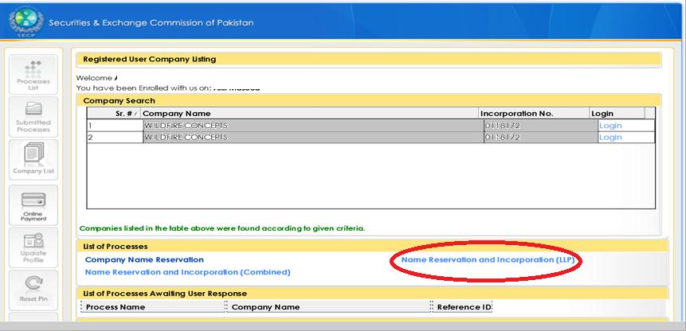
4. Login

Slide 15
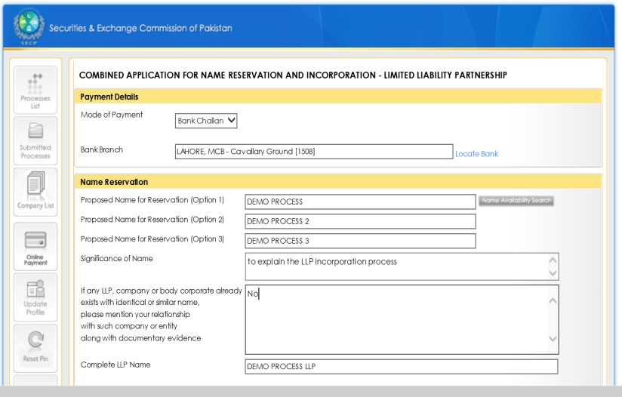
5. Fill in the combined form:

Slide 16
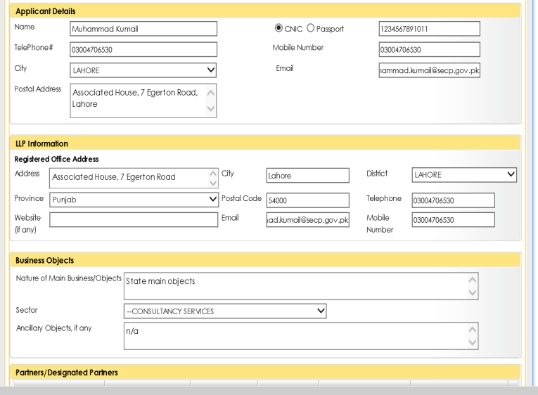
6. cont…

Slide 17
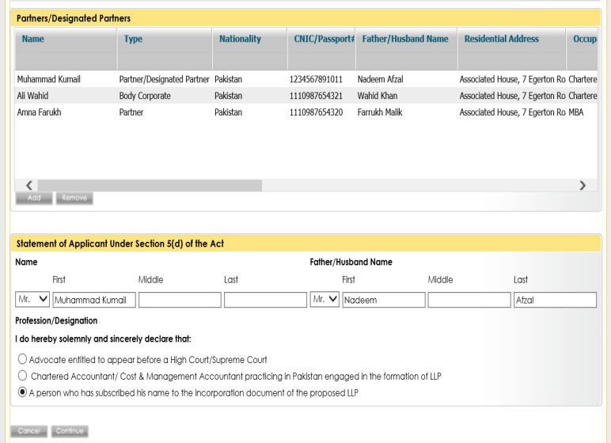
7. cont…

Slide 18
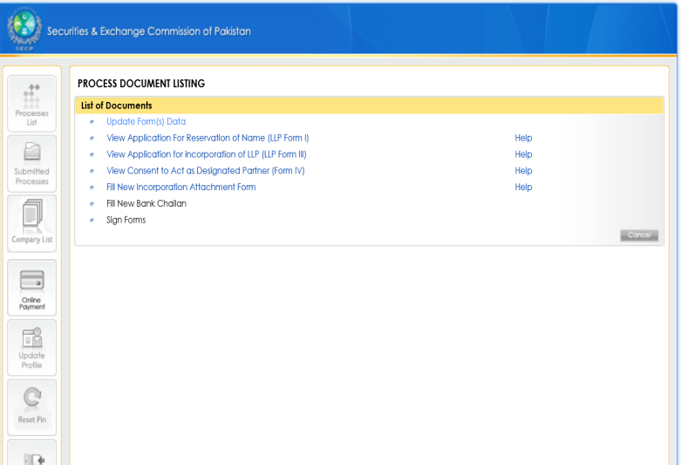
8. Review application

Slide 19
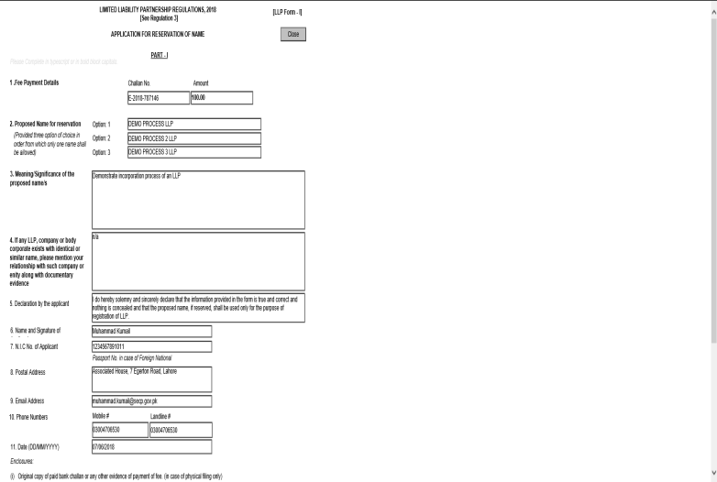
9. cont…

Slide 20
10. cont…:

Slide 21
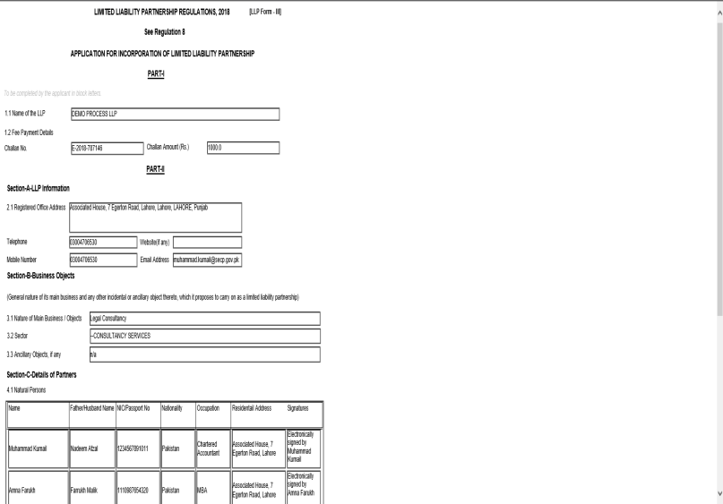
11. cont…

Slide 22
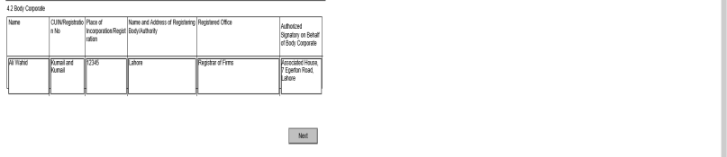
12. cont…

Slide 23
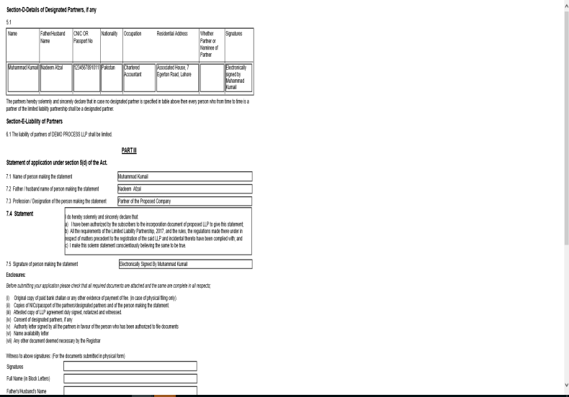
13. cont…

Slide 24
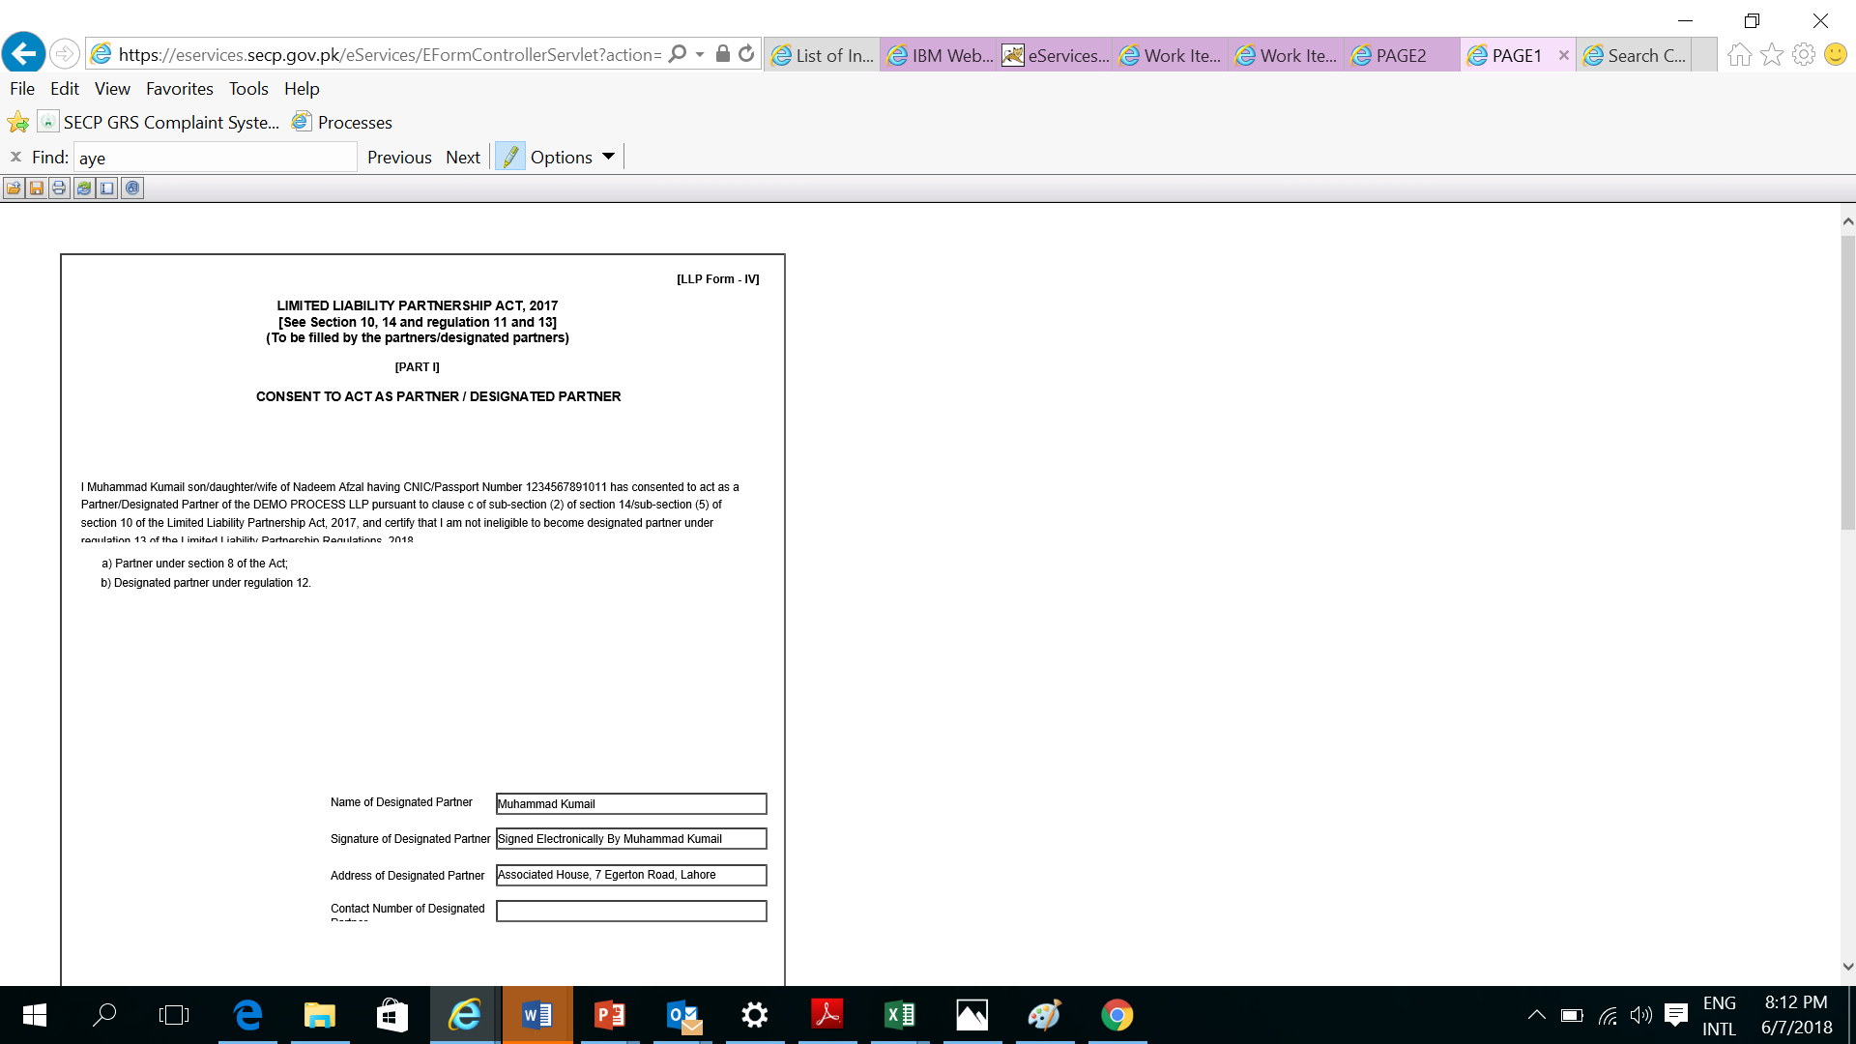
14. cont…

Slide 25
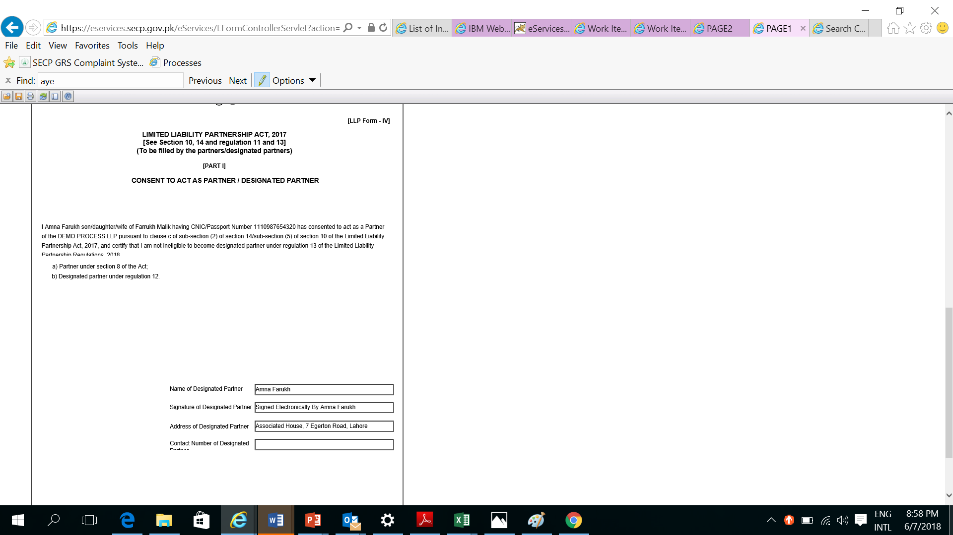
15. cont…

Slide 26
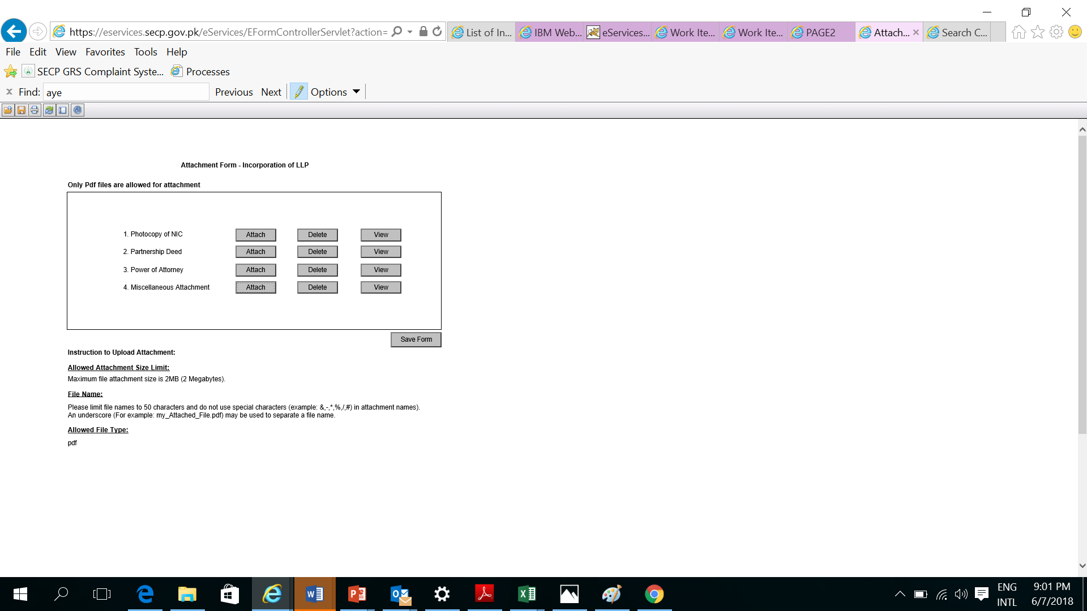
16. Attach requisite docs

Slide 27
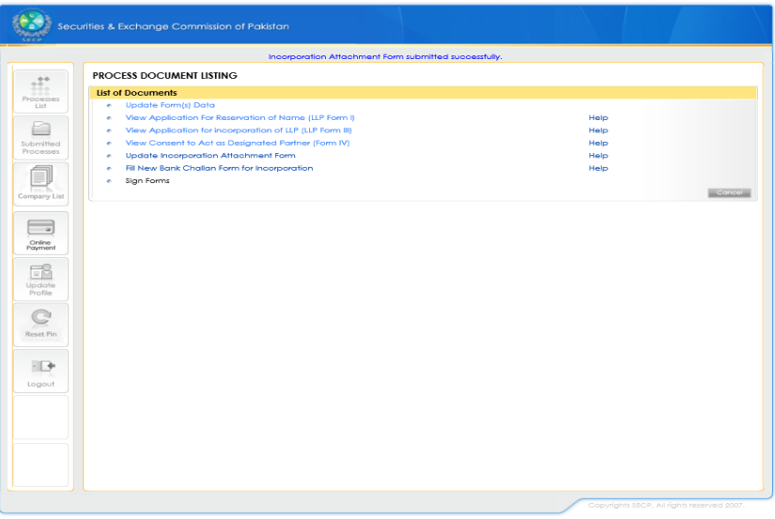
17. cont…

Slide 28
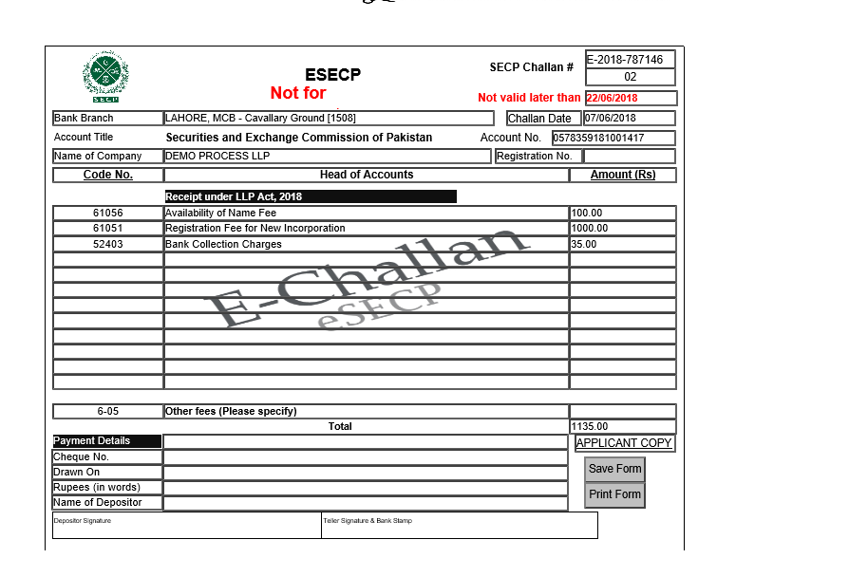
18. Save challan form

Slide 29
Fee Schedule under LLP regulations, 2018
Item | Online Rs. | Offline Rs.
Reservation of Name | 100 | 200
Rectification/Change of Name | 500 | 1,000
Registration of LLP | 1,000 | 2,000
CTC (per document) except LLP agreement and financial statements | 100 | 200
CTC of LLP agreement and financial statements, calculated at the rate per page, subject to a minimum fee of one hundred rupees | 10 | 20
For filing or registering any notice, accounts or document, required to be filed or registered under the Act | 100 | 200
For inspection of documents and register of LLP kept by the registrar | 100 | 200
Conversion of Firm to LLP | 500 | 1,000
Conversion of Private Limited Company to LLP | 500 | 1,000
Appeal | 500 | 1,000
For providing a system generated list of LLP registered with the Commission, a fee at the rate per data field, subject to a minimum fee of Rs.500 | 2 per data field | 2 per data field
For a system generated LLP profile, per LLP, a fee of … | 100 | 100

Slide 30
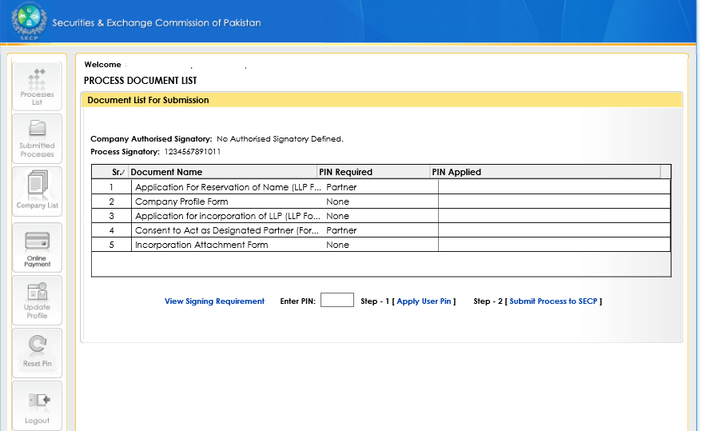
19. Sign and submit form

Slide 31
Important Forms/Filling Requirements
Title | Time Line
LLP-Form-I (Application for Reservation of Name) | NA
LLP-Form-II (Application for change/rectification of Name) | NA
LLP-Form-III (Application for Incorporation of LLP) | NA
LLP-Form-IV (Consent to Act as Partner/Designated Partner) | Within 15 days
LLP-Form-V (Notice of Induction and Cessation of Partners and Designated Partners) | Within 15 days
LLP-Form-VI (Application for Conversion of Firm or Private Company into LLP) | NA
LLP-Form-VII (Change of Registered Office) | Within 15 days
LLP-Form-VIII (Change in LLP Agreement) | Within 7 days

Slide 32
THANK YOU

